Slide 1
Communication Technologies ---Messaging (Message-Oriented Middleware)

Slide 2
Module Outline
Objectives
On completing this module, you will be able to:
Understand basic concepts of Message-Oriented Middleware (MOM)
Understand basic concepts of the Advanced Message Queuing Protocol (AMQP)
Understand different AMQP settings that can be useful for different communication patterns
Topics
MOM
AMQP
Exchange, Queue, Binding Key / Routing Key
RabbitMQ

Slide 3
Message-Oriented Middleware

Slide 4
Message Oriented Middleware
MOM is a software which sits between two or more applications or (micro)services and allow them to exchange data in the form of messages
Application A
Application B
Application Code
Application Code
Communication
Code using
Messaging API
Communication
Code using
Messaging API
MOM
Server
Notes:
The applications (either senders or receivers) can be called clients of the MOM server.

Slide 5
Message Oriented Middleware
Application A
Application B
Application Code
Application Code
Communication
Code using
Messaging API
Communication
Code using
Messaging API
MOM
Server
Service C
Service D
Service Code
Service Code
Communication
Code using
Messaging API
Communication
Code using
Messaging API
Notes:
The connections overall form a hub-spoke architecture pattern, in contrast to peer-to-peer connections in invocation-based communication technologies.
Beyond the course scope:
There are also messaging technologies without relying on a central broker, e.g., ZeroMQ (a.k.a., ØMQ, 0MQ, or ZMQ), for peer-to-peer messaging; each peer/point in the network provides some capabilities of a broker.

Slide 6
Common Message Structure
Networking / communication technology related info
Properties / metadata of the message
Body / business data
Notes:
Networking part is usually protocol/technology dependent (headers);
Properties are usually key-value pairs;
Body contains application-specific business data;

Slide 7
Sample Message Structure for An AMQP Message
Networking / communication technology related info: <BlockingChannel impl=<Channel number=1 OPEN conn=<SelectConnection OPEN transport=<pika.adapters.utils.io_services_utils._AsyncPlaintextTransport object at 0x03A700D0> params=<ConnectionParameters host=localhost port=5672 virtual_host=/ ssl=False>>>> <Basic.Deliver(['consumer_tag=ctag1.8d2bc570099a4128b1abc19953315247', 'delivery_tag=1', 'exchange=order_topic', 'redelivered=False', 'routing_key=order.info'])>
Properties / metadata: <BasicProperties(['correlation_id=8c7cf2b5-4199-4ddf-98ba-c3b43fa9f8a3', 'delivery_mode=2', 'reply_to=none'])>
Body / business data: {"customer_id": "Apple TAN", "order_id": 10, "timestamp": "2020-01-02 00:44:27.021964", "order_item": [{"book_id": "9781434474234", "quantity": 1, "item_id": 1, "order_id": 10}, {"book_id": "9781449474212", "quantity": 1, "item_id": 2, "order_id": 10}]}
Notes:
Actual format of a message depends on the broker's specification and implementation, and the specific details are beyond the course scope.

Slide 8
Advanced Message Queuing Protocol (AMQP)
An open standard protocol for MOM
Define a message format that allows standard and extensible representations of various types of data
(In theory) Provide interoperability among different AMQP-compliant implementation software that can be used on either the client side or the server side
Supports various communication patterns
One-to-zero, One-to-one, one-to-many, fire-forget, request-reply, etc.
RabbitMQ is an implementation of AMQP
pika is a python module for clients in python to interact with AMQP / RabbitMQ servers.
Notes:
Interoperability refers to the ability of different systems, devices, applications, or services to communicate, exchange data, and work together seamlessly without requiring extensive modifications.

Slide 9
RabbitMQ

Slide 10

RabbitMQ
RabbitMQ is a message-queueing software;
It supports AMQP (and other protocols)
It can be called a message broker or queue manager
Publisher
Message Queue
Subscriber
Message #2
Message #1
Source: https://www.rabbitmq.com and https://www.cloudamqp.com
Notes:
Messaging protocols supported by RabbitMQ: various versions of AMQP, STOMP, MQTT, messaging via HTTP and WebSocket

Slide 11
RabbitMQ Messaging
The broker accepts and forwards messages
A producer (publisher) sends messages to the broker
A consumer (subscriber) receives messages from the broker
A message can be anything, including detailed business data or simply an event. E.g.,
Order message- {"order id":14, cust id:"191"}
Order event- "New order 14 created"
The broker can keep a message in a queue until a consumer takes the message off the queue
A queue is a name indicating a message storage in the broker
Many queues can be created
Many messages can be sent to one queue; the same message can be sent to multiple queues
A message is routed to a queue or queues via an exchange in the broker and key pattern matching
Source: https://www.rabbitmq.com and https://www.cloudamqp.com
Notes:
Producers/consumers can be any (micro)service or application.
Analogy to Post Office- the broker provides the functionalities of a post office; A queue in the broker is like a post box in a post office; An exchange in the broker is like a postman who dispatches mails into different post boxes.
A queue may or may not be durable; if not, a message sent to the queue may be lost if the broker reboots or if there is no subscriber when the message reaches the queue.
An exchange may or may not be durable; if not, the exchange would be gone if the broker reboots.
A message may or may not be persistent (delivery_mode=2 or pika.spec.PERSISTENT_DELIVERY_MODE); if not (i.e., delivery_mode=1 or pika.spec.TRANSIENT_DELIVERY_MODE), the message would be dropped if there is no receiver online when the message is sent.

Slide 12

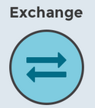


RabbitMQ Messaging - Exchange
Message Queue
P
C
Message #2
Subscribe to a queue to receive messages
Publish a message with a routing key
Message #1
Each queue is bound to some exchange(s) via a binding key
Notes:
Different exchange types can support different communication patterns.
Exchange is like a postman

Slide 13
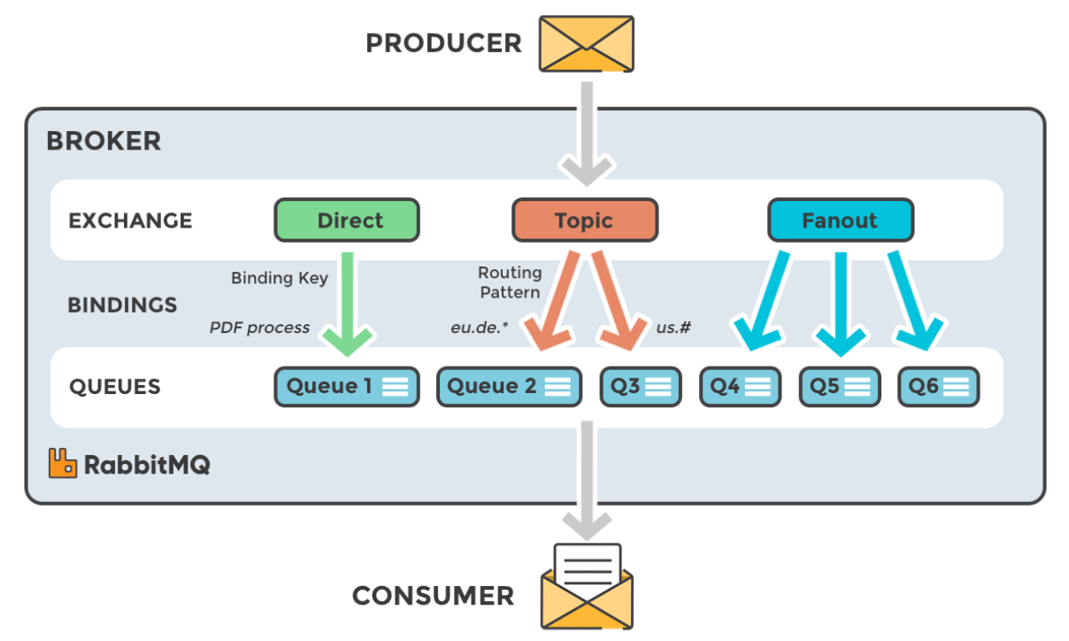
Types of Exchanges
Producer sets a routing key for a message and sends it to an exchange
Consumer subscribes to some queue(s) to receive messages
Notes:
Queues are bound to some exchanges via binding keys / patterns. Producer sets a routing key for a message and sends the message to a selected exchange in a broker. The routing key is then matched by the exchange to the binding keys. Consumer subscribes to some queue(s) to receive messages.
Sample scenarios when different types of exchanges may be more convenient for implementing the communication patterns:
Fanout: radio station broadcast / news paper subscription / email group;
Topic: select which notification to receive in your facebook account;
Direct: email address / home mail box
If multiple consumers subscribe to the same queue (bounded to the same exchanges) (AMQP 0-9-1):
Messages are load balanced among the consumers.
What Does Load Balanced Mean?
Load balancing refers to the process of distributing incoming network traffic or workload across multiple servers or resources to optimize performance, improve reliability, and prevent any single server from being overloaded. It ensures high availability, fault tolerance, and efficient resource utilization in distributed systems.
How Load Balancing Works
A client sends a request (e.g., visiting a website or accessing an application).
The load balancer receives the request and determines which server to forward it to based on factors like server health, current load, and request type.
The selected server processes the request and sends the response back to the client.
If a server fails, the load balancer redirects traffic to other healthy servers, ensuring availability.

Slide 14
Types of Exchanges
Direct: A direct exchange delivers a message to a queue whose binding key to the exchange matches exactly the routing key of the message sent to the exchange
Topic: A topic exchange does a wildcard match between the routing key of a message and the binding keys of the queues bound to the exchange
I.e., a message is sent to a queue if the queue is bound to the exchange and the routing key of the message matches the wildcard pattern of the binding key of the queue
Fanout: A fanout exchange routes a message to all of the queues that are bound to it
Notes:
A key is a sequence of words separated by ".“
Wildcards:
matches any one word; # matches zero, one, or many words;
A queue is bound with "order.*" → Matches "order.created", "order.updated" but NOT "payment.processed".
A queue is bound with "order.#" → Matches "order.created", "order.updated.shipping", "order.completed.payment" (any number of words after "order").
A message with routing key "user.login" will not be routed to queues expecting "order.#".
Topic exchanges with proper binding keys can be used to implement the same functionality of direct / fanout exchanges too.
Q: which communication patterns can be implemented by which type of exchanges more conveniently?
One-to-one: direct
One-to-all: fanout
One-to-selected many: topic
Fire-forget: direct/fanout/topic
Request-reply: may be implemented as two one-way messaging

Slide 15
RabbitMQ/Pika Programming Model for Python
Create Connection
# create a physical network connection to the broker
connection = pika.BlockingConnection(…)
Create Channel
# create a virtual lightweight connection (session) to the broker for an application/microservice
channel = connection.channel(…)
Declare Exchange
# create an exchange if it doesn't exist in the broker
channel.exchange_declare(…)
Declare Queue
# create a queue if it doesn't exist in the broker
channel.queue_declare(…)
Bind Queue
# bind a queue to an exchange in the broker
channel.queue_bind(…)
Consume Messages from Queue
Prepare Message Content
channel.basic_consume(…)
channel.start_consuming()
Publish Message(s)
Process Message
on_message_callback=…
channel.basic_publish(…)
Close Connection / Channel
connection.close()
Notes:
The connection/channel to the broker needs to be set up for each/every run of a publisher or a consumer.
The set-ups of exchange/queue may need be done only once for all sessions/connections; they can be done separately via RabbitMQ management GUI or an automated script.
In the same session/connection, a publisher/a consumer can publish/consume many messages.
"on_message_callback" refers to a function that is defined in the consumer; the function can do anything with the message received according to the business requirements.
“basic_consume” sets up a consumer and binds the “on_message_callback” function to all messages to be received.
“start_consuming” starts a loop to wait to receive any message from the queue, and automatically invokes the "on_message_callback" function to process each of the messages received. Use Ctrl + C in the cmd windows to terminate it.

Slide 16
References
Part 1 RabbitMQ for beginners - What is RabbitMQ?
https://www.cloudamqp.com/blog/part1-rabbitmq-for-beginners-what-is-rabbitmq.html
RabbitMQ Tutorials
https://www.rabbitmq.com/getstarted.html
Pika Python AMQP Client Library
https://pypi.org/project/pika/

